Slide 1

IT Support at the University of Manitoba
Janice Sisson – Director, Client Services
Marvin Kocay – Acting Exec. Dir., IST

Slide 2

Current State:
IT grew up in different pockets around the University
Support for IT grew up around it
Faculties and departments had to hire their own IT support resources to provide
functions central IT couldn’t fund
Resulted in a decentralized support model
Resulted in decentralized IT decisions

Slide 3
Current State:
Centralized IT provides:
  Enterprise systems (HR, Finance, Student, Libraries, Advancement, Research LMS)
  A single University network and single email system across campus (with some exceptions)
  Integrated help desk, account management, telephone and A/V
Distributed IT support staff provide:
  Desktop support
  Support for unique faculty or department software
  Research IT support

Slide 4
Current State Issues:
Assortment of desktop equipment on campus (computers and printers)
Assortment of desktop software tools (email clients, browsers, word processers)
Assortment of purchasing arrangements, prices, suppliers
No advantage of institutional buying power
Talented but siloed IT support staff
Many distributed applications do not get enterprise level IT support

Slide 5
Services Review:
PWC engaged to assist with ROSE (Resource Opportunities and Service Enhancements) project
IT findings included:
Despite a central IT structure, more staff in departments than in central IST
No available data on workload of local computer staff (no logging of work)
No available data on true cost of IT support across the campus
Limited implementation of standards
No backup if local computer staff are absent
Critical resources were being supported by single individuals
Ad hoc reporting of local computer staff
Priority setting rests with local computer staff
Allocation of IT resources resides with local computer staff
Highly paid staff were performing low end tasks
Training and expertise varied from one unit to another

Slide 6
The opportunity:
IT underlies much of University operations
Too important not to have a managed environment
Provide IT support in a cost effective way
Pool resources, provide cross training, provide enterprise support for distributed
systems
Set priorities at a University level
Better understand the IT needs across the University
Lower the total cost of ownership for IT assets through standardization
Lower the acquisition costs of IT assets

Slide 7
Directions Set:
Create and deploy an integrated IST Service Desk
Implement an IT Procurement Centre
Implement a Print Management Program
    - Working with Xerox now on the initial assessment
Implement a communication/collaboration suite
    - Exchange for faculty and staff
    - Cloud for students

Slide 8
IST Help & Solutions Centre
Integrated all IST help functions to one facility
  Network service desk
  IT accounts office services
  Computer help desk (student and faculty/staff)
  Audio visual booking services
  Telephone services (land lines and wireless)

Slide 9
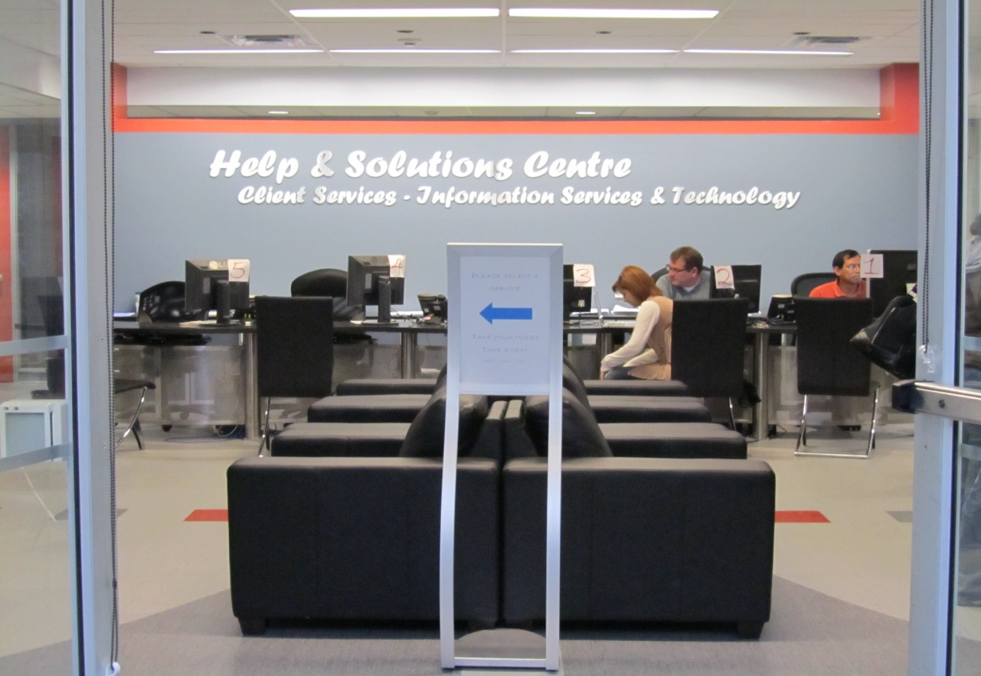
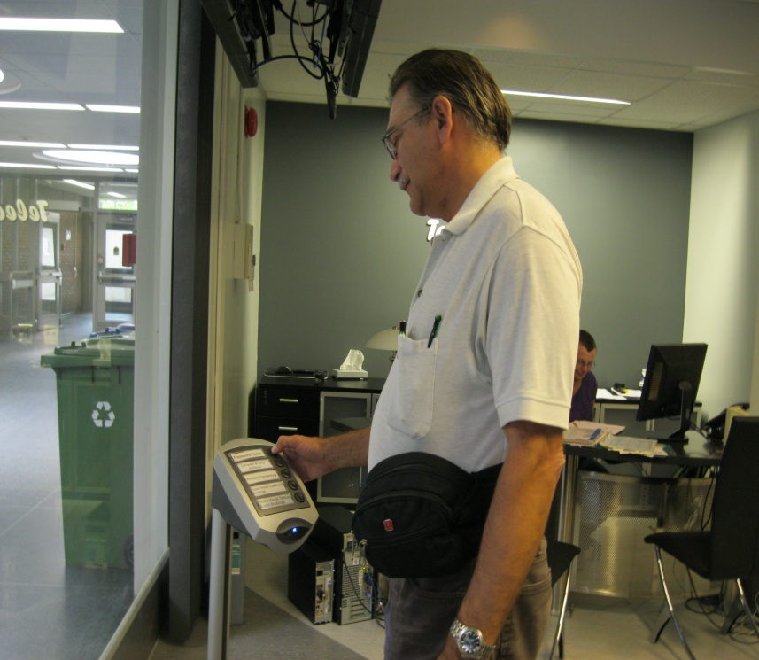
Integrated Help Desk
Q-Matic queuing system

Slide 10
Centralized desktop support service utilizing computer staff from the faculty and departments:
Completed a pilot at Medical Campus last summer
Included Medicine, Dentistry, Pharmacy
Users called a central service desk to report all IT incidents and service requests
Local computer staff were “pooled” to provide service
Requests were assigned a priority
Service desk staff attempted to solve as many problems remotely using remote desk top as possible (first point of contact resolution)

Slide 11
Pilot outcomes:
Pilot proved effective
Decision was made to roll out to both campuses (Fort Garry and Bannatyne)
Adopting a phased in approach – 800 users in initial group
Carrot vs stick approach – inclusion is negotiated for now but will become mandatory
Negotiated a standard Service Level Agreement with senior administrators in each unit
No layoffs for local computer staff – attrition and redeployment as staffing surpluses are identified
Local computer staff physically stayed in existing space
Budgets and reporting lines were moved to central IT department
Provided training to local computer staff
Adopted an ITIL framework utilizing a Tiered approach to resolution
Identified the need for IT management software

Slide 12
Facilitation:
Completed university wide asset inventory and workload analysis
  Local computer staff provided information via a mandatory on line survey
  PWC compiled data for each unit
  Data becomes discussion tool for preliminary meeting with each faculty and department
    Data received very positive reception
    Was frequently the first time Deans and Senior Administrators had seen a snapshot of their IT operations
    Great conversation starter for meeting on support
  Discussion and decision making followed on which items made sense to move centrally and which should stay with the unit
Developed a standard Service Level Agreement in negotiation with Deans and Senior Administrators in each unit involved in the initial roll out
  Final document accepted unanimously by all units involved in initial roll out
  Covers roles and responsibilities, a description of the three tiered support model, priority settings and turnaround times as well as escalation options
Worked with local computer staff one on one
  Reviewed initial asset inventory and workload analysis to update and verify information
  Collected training, skillset and expertise data for each computer staff member
  Reviewed all software managed locally to determine support requirements
  completed a detailed hardware inventory which was then loaded to the workorder software system

Slide 13
IT Management Software
Purchased Cherwell product through third party Canadian (Avante)
Purchased 40 concurrent licenses
Acquired using SAAS model
System used by all of IST
Early in adoption process
Still configuring details
ITIL based framework

Slide 14
Where we are now:
Moved most non-desktop services to central IST (locally managed servers, softwares, databases etc)
Loaded department inventory into IT management software allowing service desk staff to view client hardware immediately upon receiving calls
Installed remote desk top capability to all end users allowing service desk to attempt remote resolutions prior to send physical technical support
Provided HDI and ITIL training for each compu rep
Provided Blackberry’s to each compu rep to ease communications
Issued a series of communications to end users
Delivered posters, mouse pad, stickers to end users the day prior to “go live”
Went live April 4th

Slide 15
Shared Service Desk:
We have two Service Desks – the main one at our Fort Garry campus and a second one at the Medical campus downtown. The local computer representatives continue to reside in the various faculties and units on campus.
Support for end-user computing devices will include:
  Technical Support
  Problem determination and resolution
  Software Deployment
  Physical Deployment
  Inventory management
  Orientation/Training for New University Staff related to their desktops

Slide 16
Services covered:
Hardware includes:
  PC systems (e.g., desktop, tower, workstation, laptop, tablet, and mobile computing devices), and peripheral devices (e.g., monitors, laptop docking stations, CD / DVD burners, multi-functional devices, printers, scanners, electronic storage devices, media libraries, uninterruptible power supplies [UPS], etc.).
Software includes:
  Operating systems, office automation and productivity applications, anti-virus products, messaging and collaboration software, connectivity software, and utilities that provide functionality to the above-mentioned hardware resources
  Unique services may include:
  Server provisioning and operation, specialized software support, project development and planning. These will be addressed on a case by case basis and may involve the services of an Account Manager/liaison support through IST.

Slide 17
Tiered approach to resolution:
  Tier 1 - Service Desk staff
  Tier 2 – Computer staff located in the departments and units
  Tier 3 – Central IST staff (Computing and Networking Services, Enterprise Systems) and outside vendors providing technical support

Slide 18
Contact Info and Support Hours
Service | Coverage | Hours
Service desk and field staff support hours | Monday to Friday, excluding Holidays Staffed coverage as well as voice mail option | 8:30 – 4:30 servicedesk@umanitoba.ca 474-8600 For Garry 789-3424 Bannatyne
IT Help & Solutions Centre hours | Monday to Friday excluding Holidays Staffed coverage as well as voice mail option | 8:00 – 8:00 support@umanitoba.ca 474-8400 Fort Garry 789-3424 Bannatyne
Weekend/Holiday Coverage | Not available
Web Live Chat | As available | 8:30 – 4:30 M-F http://umanitoba.ca/computing/ist/itservicedesk/index.html

Slide 19
Response & Resolution Times
Response time (client will receive email or voice confirmation that issue has been logged) | Priority 1 (Voice, Voice Mail, Chat, In Person contact) * | 15 minutes
 | Priority 2 (Voice, Voice Mail, Chat, In Person contact) * | 45 minutes
 | Priority 3 (Voice, Voice Mail, Chat, In Person, Email contact) | 90 minutes
 | Priority 4 (Voice, Voice Mail, Chat, In Person, Email contact) | 4 hours
 | Priority 5 (Voice, Voice Mail, Chat, In Person, Email contact) | 2 days
Resolved by Service Desk Goal | First Contact Resolution Rate Goal | 40% - 80%
Target Resolution times | Priority 1 | 2 hours
 | Priority 2 | 4 hours
 | Priority 3 | 8 hours
 | Priority 4 | 4 days
 | Priority 5 | Project based

Slide 20
Prioritization Matrix
Impact * Urgency = Priority
 |  | Impact
Urgency |  | Who Affected? What is Affected? How it’s affected? | Many people Critical functions System not available VIP client or service | A few people Important function Slow performance | One person Non Critical function Intermittent symptom
 | When it’s needed? Is there a workaround? | Priority | High | Medium | Low
 | Required immediately No workarounds possible VIP client or service | High | Priority 1 | Priority 2 | Priority 3
 | Required in a few hours No workarounds possible | Medium | Priority 2 | Priority 3 | Priority 3
 | Not required today A workaround is available | Low | Priority 3 | Priority 3 | Priority 4

Slide 21
Sample chart - High Impact
Impact | Incident Definition | Example of System Affected
High | The Incident has the following attributes: Many people affected Critical Academic/Admin function affected Negative impact on critical services in 4 hours or less No Workaround is available VIP client or service | Student registration is unavailable. Learning Management system is unavailable to students and faculty. (ANGEL) A failure of a teaching workstation in a designated teaching space. A LAN/WAN failure of any type A failure of a server to which HR Representative key VIP payrolls The core Internet email/academic calendar service has failed and is required to transmit data to customers Emergency Notification including but not limited to Jump, Telecomm PBX, Call Pilot, Mailman DHCP Banner (FAST) Guts / IDM Video Security Virus Outbreak Response Classroom Software Failure Software License Server

Slide 22
Escalation
Provide a means for end users to escalate issues
Build business rules into software to assure alerts are issued for coming due or overdue incidents and service requests
Actively manage workload of local computer staff
Develop processes internally within IT organization to assure adherence to service level agreements

Slide 23
Client Relationship Manager
New position to IST
Attended meetings with Deans and Senior Administrators
Assures department needs are being addressed
Aligns the appropriate IST resources are assigned to departmental projects
Provides statistical information on service desk to end units
Provides recommendations to end units on hardware evergreening, IT issues

Slide 24
IT Procurement Centre:
Establish centre to manage IT procurement across campus
Combination of purchasing professionals and IT consultants
    - Reports to CIO
    - Dotted line to Manager of Purchasing
Strategic source IT procurement
    RFP is out for desktop computers (Windows based) servers and
    peripherals

Slide 25
Centre responsibilities:
Three principle services delivered
  - Setting up IT procurement contracts/standards
  - Consulting services for acquiring IT assets
  - Managing the procurement process
Coordinate IT requirement forecasts
Prepare, issue and manage RFx’s
Includes IT, network, a/v equipment; consulting services; software;
telephony

Slide 26
Implementing the Centre:
Defining the ITPC Target Operating Model
Establishing Governance Structure
Executing an RFP for standard PC’s, Servers and Peripherals

Slide 27
Defining the Target Operating Model:
Mapping current Processes
  Computers on Campus within the Book Store manage the standard PC
  program
  - Purchasing manages the procurement process
Mapping the new operating model
  Working on how to incorporate Computers on Campus into the
  delivery model
  For PC’s will be driven by service models proposed through the PC
  RFP process

Slide 28
Overview of Process:
Faculty identifies need for IT.
    - In conjunction with Client Relationship Manager
Consult with ITPC on standards, options
  - Is there a strategic sourcing agreement in place
  - What special requirements are there
  - Is purchasing outside of the standard ok?
Create appropriate purchasing documentation
Ensure vendor provides services as agreed to
Work with Shard Service desk on implementation

Slide 29
Centre Governance:
Operations committee
  - Led by client relationship manager
  - Group that provides feedback and advice to Centre
  Membership drawn from those directly involved from across
  University
Advisory Committee
  - Sets policy and priorities for Centre
  - Provides input into overall University IT advisory committee
  - Membership consists of IT senior management

Slide 30
PC RFP:
Spend analysis
    - Extract information from finance system
    - Use of Spend Radar to analyze, categorize data
Develop ‘Basket of Goods’
    - Represents standard PC, Server
Develop RFP
    Expectation of full services including hardware, base image,
    delivery, warranty and support, removal of old equipment,
    certification of wiping hard disk, data migration to new PC
    - Providing portal for on-line ordering.
    - Pricing that is verifiable and will not be undercut through sales.
    Pricing not based on sales volume; adjusted as product specs
    change
Evaluation tool for RFP
    - Technical, Services and Target Operating Model

Slide 31
ITPC Benefits:
Reduced Cost
Standardized Desktops
Full service from vendor
Repeatable processes for procurement
Improved management of IT assets on campus
Reduced Support Costs
Reduced costs of IT procurement processes

Slide 32
Conclusions - Future State:
Standard service delivery through a Shared Service Desk
Standardized IT equipment through the ITPC and Print Management
Standardized desktop tools – email, calendar etc
Record and manage IT work on campus
    - Understand the nature of the work
    - Understand how to improve IT service delivery
Reduced support costs and enhanced services.

Slide 33
The Reaction:
Administrative units are understanding/supportive
Some Deans are very supportive and want to be part of it
Some Deans are skeptical or not supportive
  - A central Service Desk will not understand their unique IT needs
  IT people do not support computers, they support people using
  computers
  - They want a relationship with the person supporting them
Fire on campus created understanding of need for standardization
Computer support staff are concerned
  - Worried about jobs
  - Worried about having a diminished role

Slide 34
Lessons Learned:
Have a strong imperative to change.
  Our ROSE project created an expectation that changes are needed for the University
  Analysis of financials and processes aided the case for change
Don’t underestimate the importance of budget and control to end users
  Issues will be political and cultural
  There is a perception of loss of control of IT to the end units
  Building trust with end users takes time
Must have end user acceptance (buy in)
  Communicate, communicate, communicate
  Do your homework – understand their IT needs and services (inventory was very effective)
  Expectations vs. realistic capabilities
  Expect resistance to change from both local computer staff and end users
Local computer staff become your team
  Use perks to achieve buy in - Blackberry’, training opportunities
  They will determine your success or failure
Expect service affecting delays
  Process development takes time
  Difficult to plan workload and necessary staffing requirements with no historical data to rely on
  Priority 1’s often exceed resolutions due to vendor contracts, parts etc.

Slide 35
Final Thought:
IST needs to be more inclusive and better understand the needs of
faculties and departments.
    - Conclusion of IST Service Review led by PWC
We’ll have detailed knowledge of the IT needs of faculties and
departments
We’ll have the resources to meet those needs
We’ll be able to solve problems quickly, provide specialization, and
enterprise level application support.

Slide 36
Questions/comments?
Janice_Sisson@umanitoba.ca
204.474.9853
Marvin_Kocay@umanitoba.ca
204.474.9904

